Slide 1





Biomechanical Energy Harvester for Health Monitoring
Faculty Advisors: Dr. Caruntu & Dr. Fuentes
Course Advisor: Dr. Sarkar
Ezequiel Juarez
Christian Quintero
Bonifacio Salinas
Jaime Sifuentes

Slide 2

Outline
Overview
  Elevator Speech
  Background Research
  Competitive Products
Final Design
  QFD
  Problem Definition
  Functional Decomposition
  Final Design
  Circuit Design
Market Analysis
  Prototype/Production Cost
Manufacturing Process
  Bill of Materials
  Assembly
Test Protocol
  Moment of Inertia
  LabVIEW
  Running &Walking
Results & Data Analysis
Summary

Slide 3

Overview

Slide 4
Elevator Speech
Health Monitoring Systems (H.M.S) currently limited by batteries
Bio-Mechanical Energy (B.M.E) = alternative source of power
B.M.E. + H.M.S. = New Opportunity
Impact: Health and Environment
  Diabetes
    26% of adults 65 and older
    Over 6 million increase form 2010 to 2012
    7th leading cause of death
    76,000 people in Rio Grande Valley
  Environment
    Environmentally friendly
    Minimize waste

Slide 5
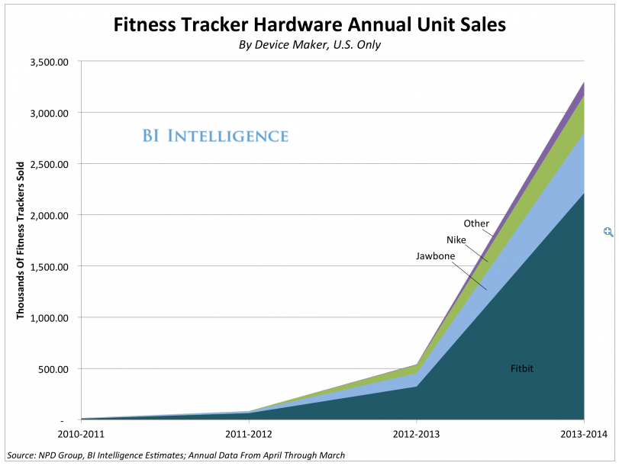
Background Research
Market Size: 1 in 10 adults.
  24 million fitness tracker users.
Average price:
  $140
Total Market Value:
  $3.4 Billion
Projected Market Capture:
  5%
Actual Market Value:
  $170 Million

Slide 6
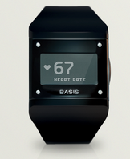
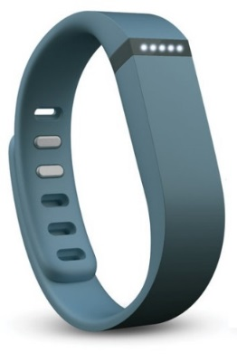
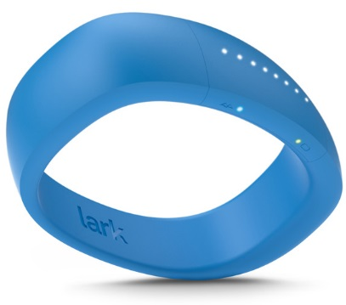
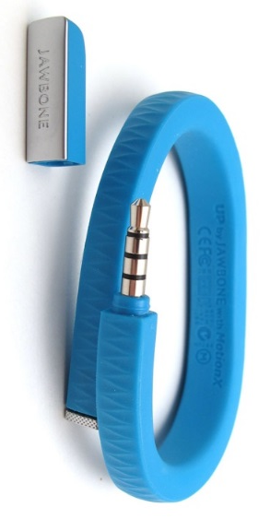
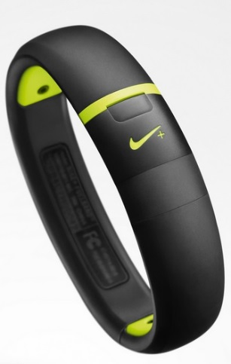
Competitive Products
1.
2.
1
2
3
4
5
3.
4.
5.

Slide 7
Final Design

Slide 8
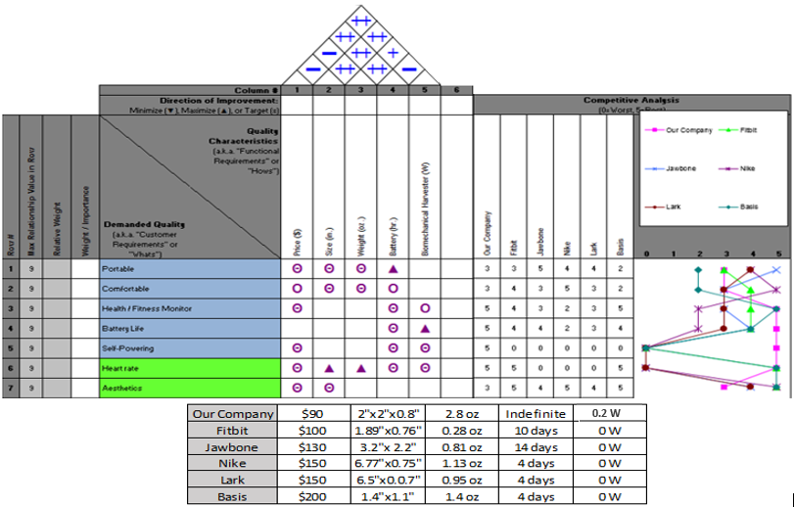
Quality Function Deployment

Slide 9
Needs Wants
Problem Definition
Portable (<120g)
Comfortable (all day use)
Health/Fitness Monitor
Battery Life Extension
Heart Rate
Aesthetically appealing
Pedometer
Self-Powering
Objectives Constraints
Increase efficiency
Decrease size/Weight < 120g
Cost Under $100
Health Monitoring Device
Target Efficiency > 2%
Comfort (Full day)
Size (2.75"x0.8" )
Weight (<120g)
Cost ($100)

Slide 10
Functional Decomposition
Generator
Health Monitor
Battery

Slide 11
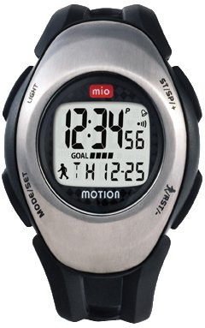
Sub-Function 1- Selection
Health Monitor Decision
 | Dimension | Cost | Power | Score
Mio | 0.049 | 0.222 | 0.197 | 0.469
ePulse2 | 0.012 | 0.049 | 0.197 | 0.259
GlobalSat | 0.049 | 0.172 | 0.049 | 0.271
Battery Voltage: 3.7 V
Battery Life: 13 Hrs.
Power Consumption: 86 mW

Slide 12
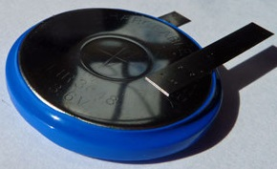
Sub-Function 2- Selection
Battery
 | Dimension | Cost | Capacity | Score
LIR | 0.148 | 0.074 | 0.185 | 0.407*
PCBM | 0.074 | 0.037 | 0.074 | 0.185
VL | 0.222 | 0.111 | 0.074 | 0.407
Volts: 3.6 V
Capacity: 300 mAh
Diameter 30 mm
Weight: 7.3 g
Price: $ 9.50
*Capacity / Cost Ratio WINNER!

Slide 13
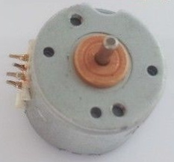
Sub-Function 3- Selection
Generator
 | Dimension | Weight | Power | Total
SONGLE | 0.056 | 0.167 | 0.111 | 0.334
NIDEC | 0.028 | 0.25 | 0.167 | 0.445
MINI | 0.084 | 0.084 | 0.056 | 0.223
Step angle 18°
Step angle tolerance 0.3°
Holding torque at Un 0.15cNm
Direction of rotation reversible
Electrical data
Drive Method 2-2 PHASE
Number of windings 2/4
Rated voltage Un 5V
Current /phase 500mA
External dimensions Φ15X11mm

Slide 14
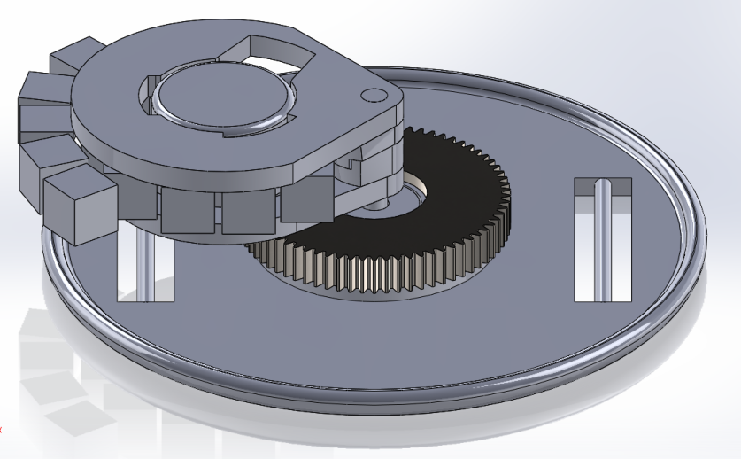
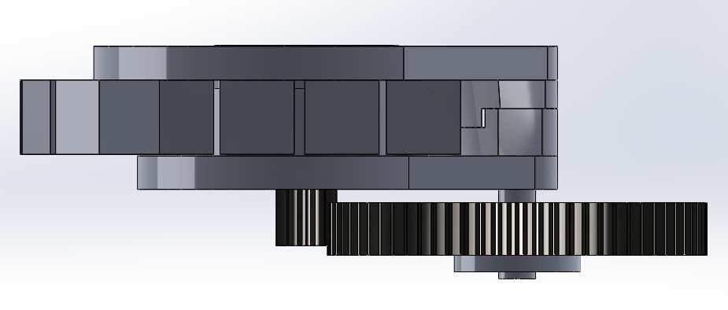
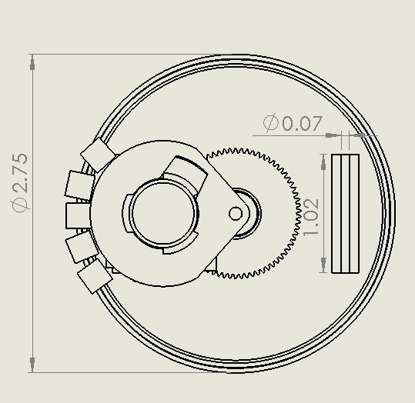
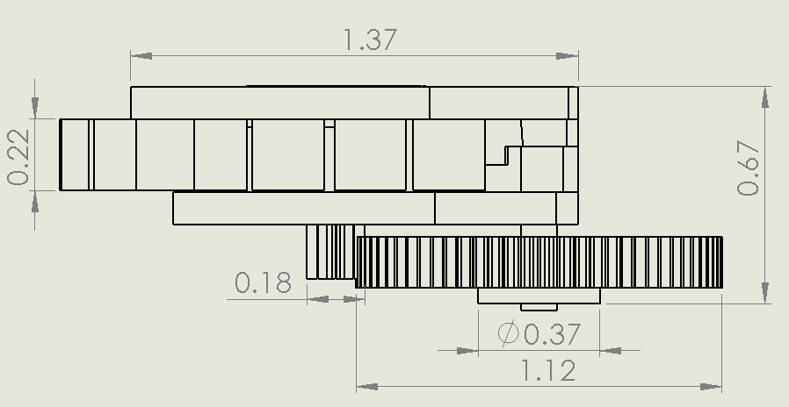
Final Design
All measurements are in inches.

Slide 15
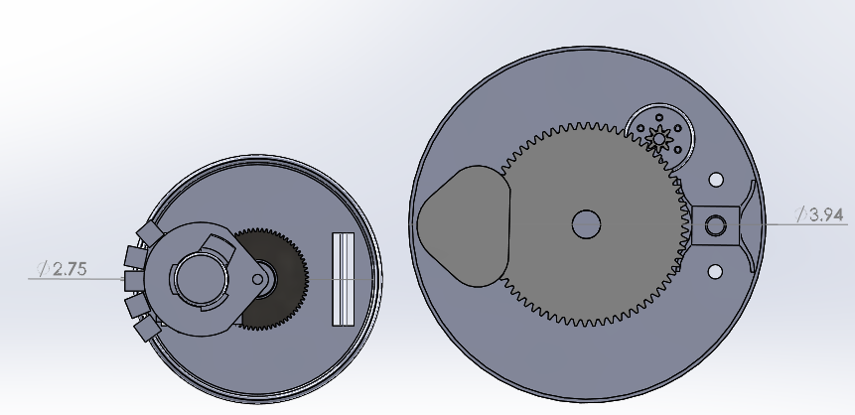
Comparison
Dimensions in inches

Slide 16
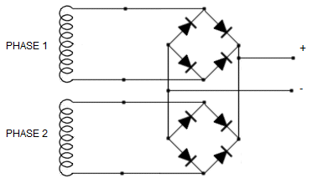
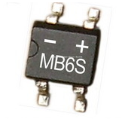
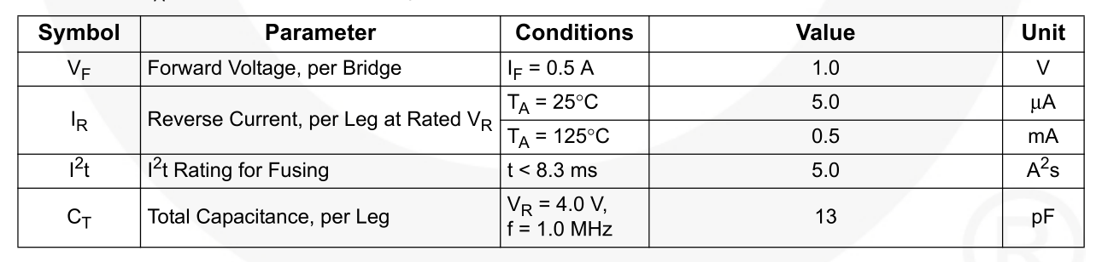
Circuit

Slide 17
Market Analysis

Slide 18
Prototype Cost
Material Cost
  $60
Estimated Labor Cost (4 Hours @$40/Hour)
  $160
  Total Prototype Cost: $220

Slide 19
Production Cost
Material Cost
  $ 8 per unit (not including health monitor)
Number of Labors
  25 for assembly and 5 engineer
  100,000 units per year
Labor Cost
  $18 per unit with 30% benefits
Estimated Production Cost
  $32 per unit with 20% overhead
  $62 per unit including HM
Distributor / Wholesale Price (30% Profit)
  $80 per unit including HM

Slide 20
Market Analysis
Distributor Cost $80
Retail Price $105
  30% Profit
Target QFD Price $90
Market Size: $10.5 Million
Competitive price $100-$200

Slide 21
Manufacturing Process

Slide 22
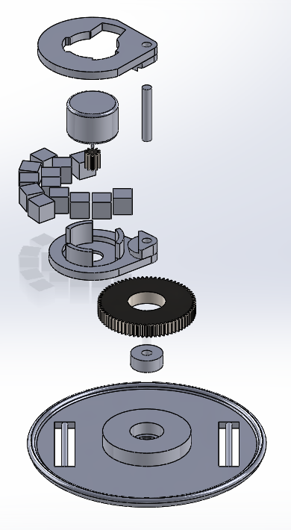
Manufacturing Process for Prototype
3
Create plastic parts using 3D printing process
  1 – Case
  2 &3– Pendulum
Press-fit bearing (4) to case(1)
Epoxy large gear (5) to case (1)
Press fit shaft (6) into the bearing (4)
Super glue small gear (7) to generator (8)
Adhere generator (5) to pendulum (2&3)
Mount tungsten weights (9) on pendulum
Press fit pendulum (2&3) on to shaft (6)
Wire generator (5) phases onto bridge rectifier
8
6
7
9
2
5
4
1

Slide 23
Bill Of Materials - Prototype
Material | Qty | Provider | PPU | Total
Spur Gear 70T 64P | 1 | World of RC Parts | 5.75 | 5.75
Spur Gear 10T 64P | 1 | VRC Hobbies | 2.49 | 2.49
Sankyo A55 Motor | 1 | China | 2.69 | 2.69
MB6S Rectifier | 2 | Mouser | 0.4 | 0.8
Joule Thief | 1 | Greece | 5.25 | 5.25
Bearing | 1 | RC Bearings | 1.60 | 1.60
 |  |  | TOTAL | 19.96

Slide 24
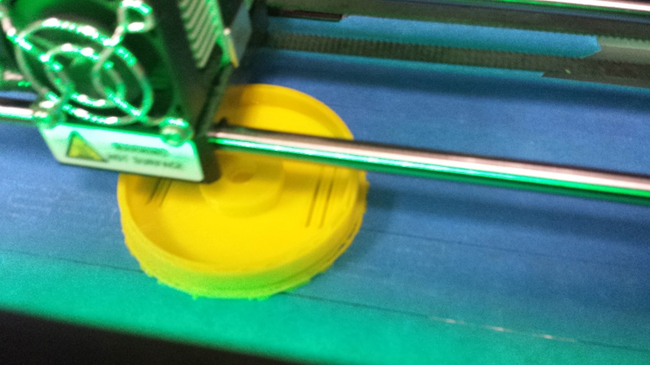
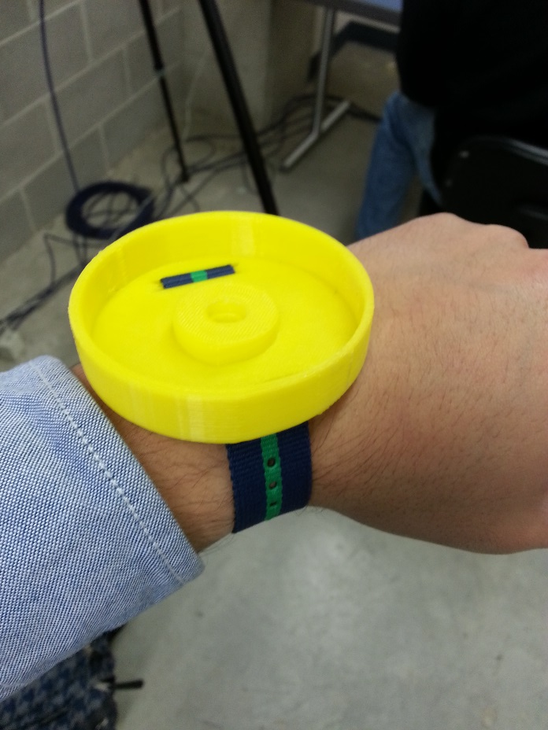
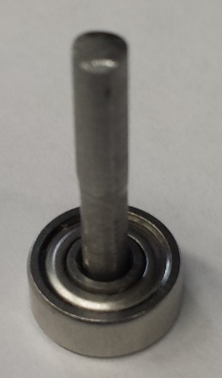
Manufacturing Process
3D Printing case – Using Makerbot
Press fit shaft into bearing
Test Fitting Strap

Slide 25
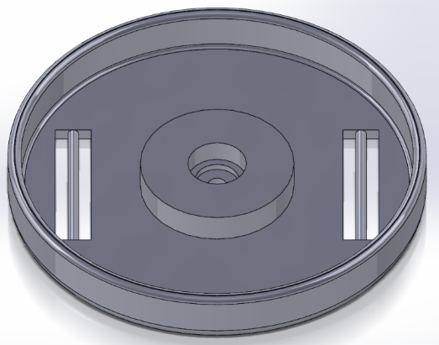
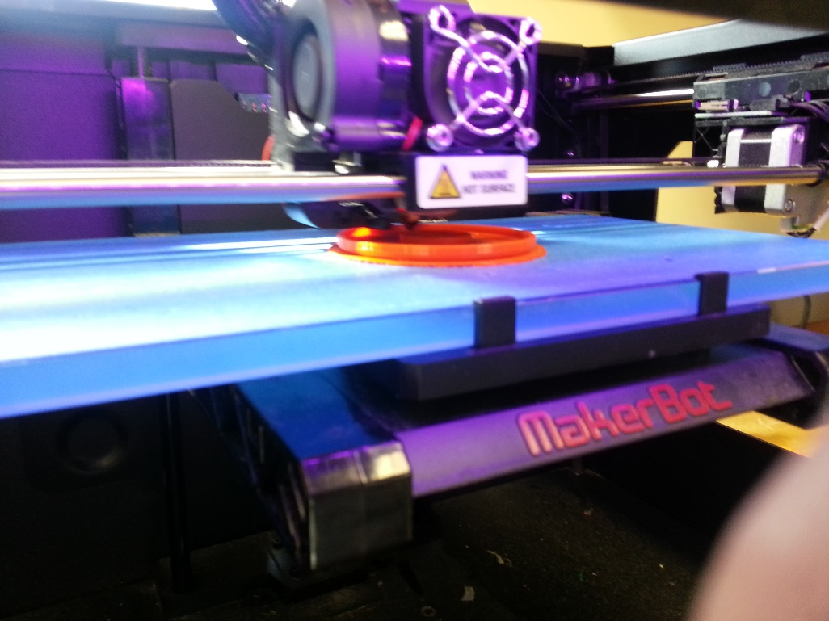
3D Print - Case
Decreased case size to shorten printing time.
Changed dimensions slightly to better fit parts.

Slide 26
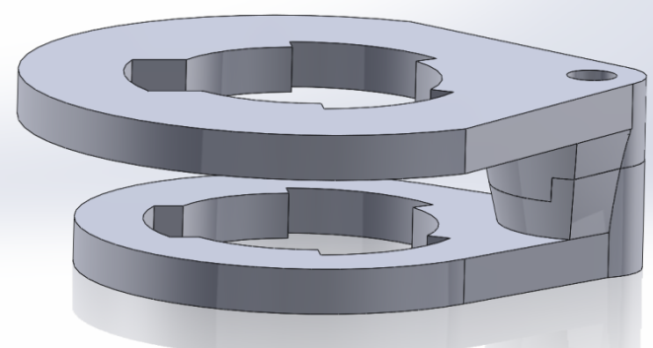
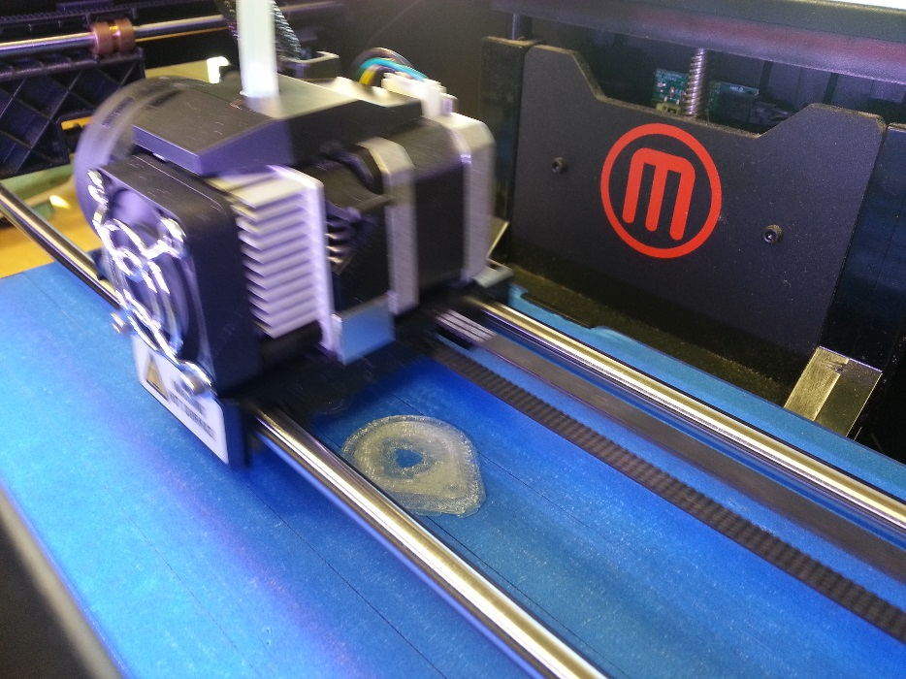
3D Print – Pendulum Arm
Split pendulum design into 2 pieces.
  Improved ease of printing
  Decreased printing time

Slide 27
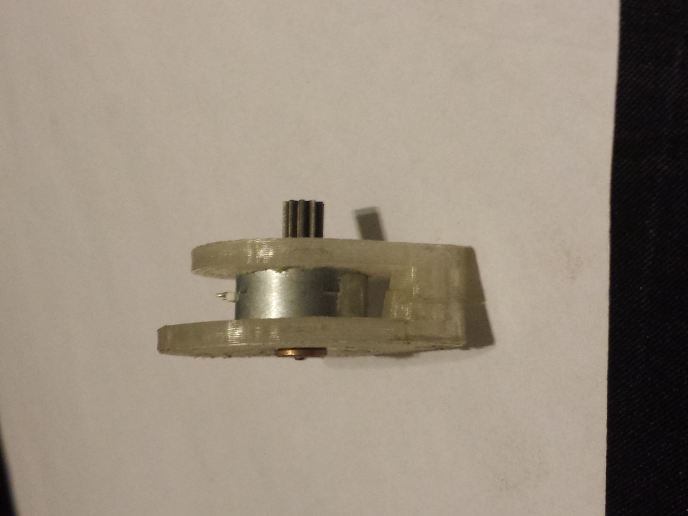
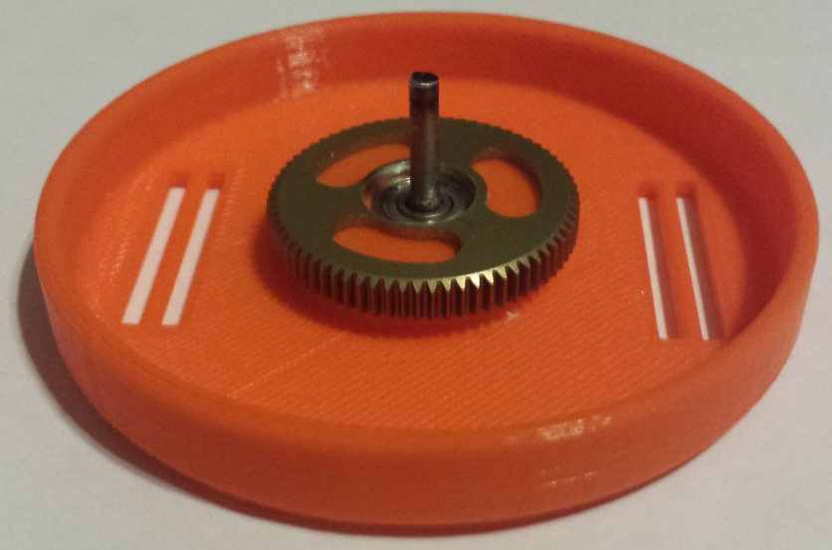
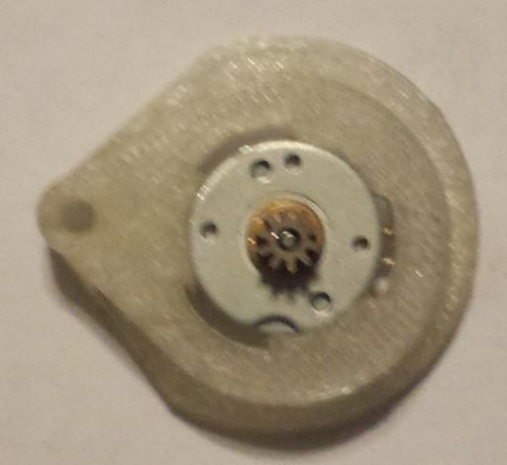
Assembly
Fit generator onto pendulum armature
Fit bearing-shaft and 70T gear onto case.

Slide 28
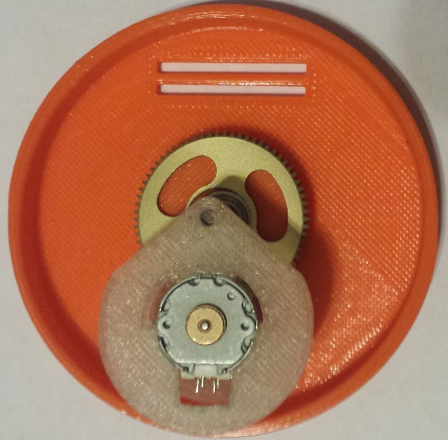
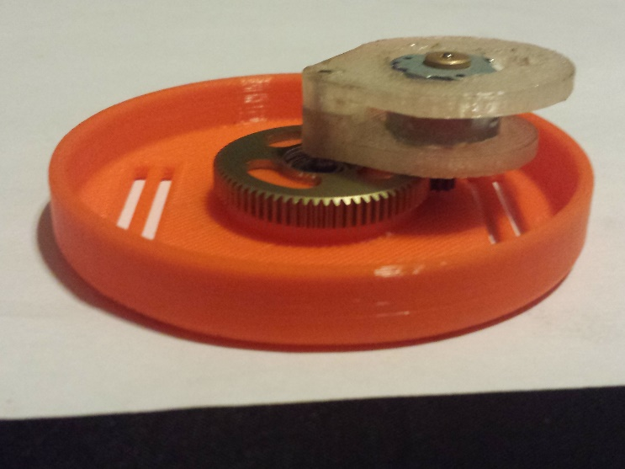
Assembly Continued
Affix pinion gear onto generator
Fit pendulum arm onto steel shaft

Slide 29
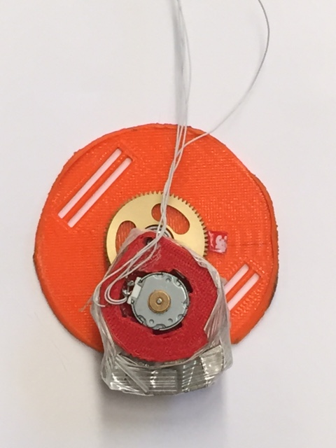
Final Design
Case
70 Tooth Gear
Generator
Pendulum
Tungsten Weights

Slide 30
Test Protocol

Slide 31
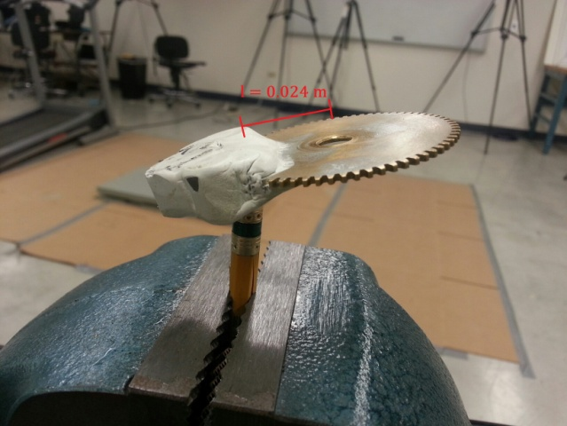
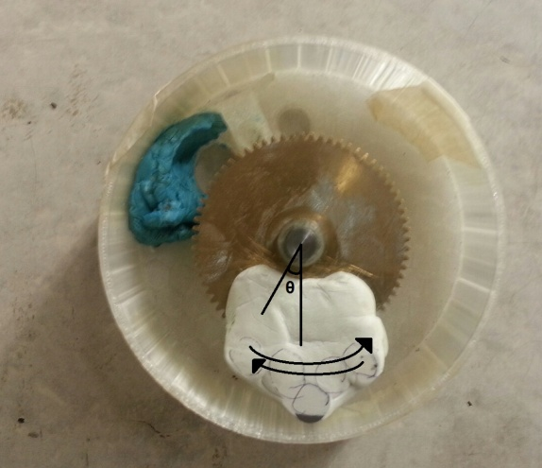
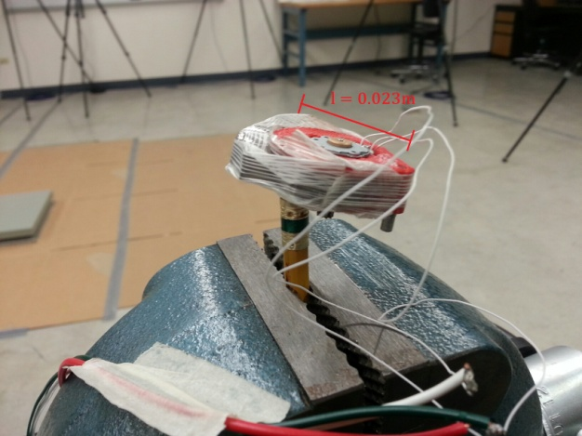
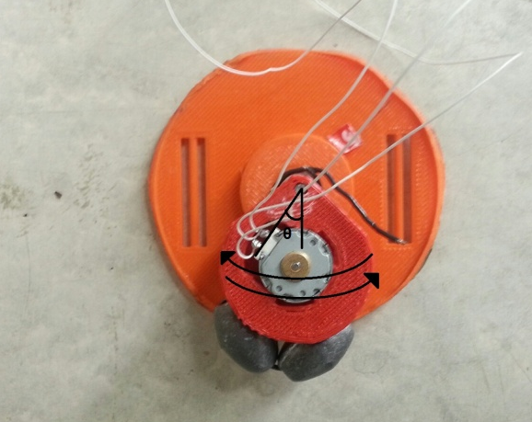
Moment of Inertia
Center of mass – Length Arm
Period of Small Oscillation
Old Device
 | L (m) | M (kg) | T (s)
OLD | 0.024 | 0.11413 | 0.573
NEW 1 | 0.0286 | 0.04214 | 0.338
NEW 2 | 0.0229 | 0.07314 | 0.339
Old Device
NEW 2 Device
Old J = 2.237 x 10⁻⁴ kg m²
NEW 1 J = 3.471 x 10⁻⁵ kg m²
NEW 2 J = 4.772 x 10⁻⁵ kg m²
NEW 1 Device

Slide 32
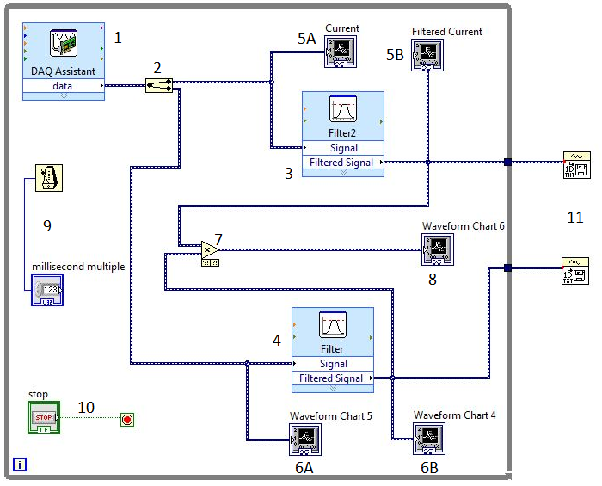
Labview

Slide 33
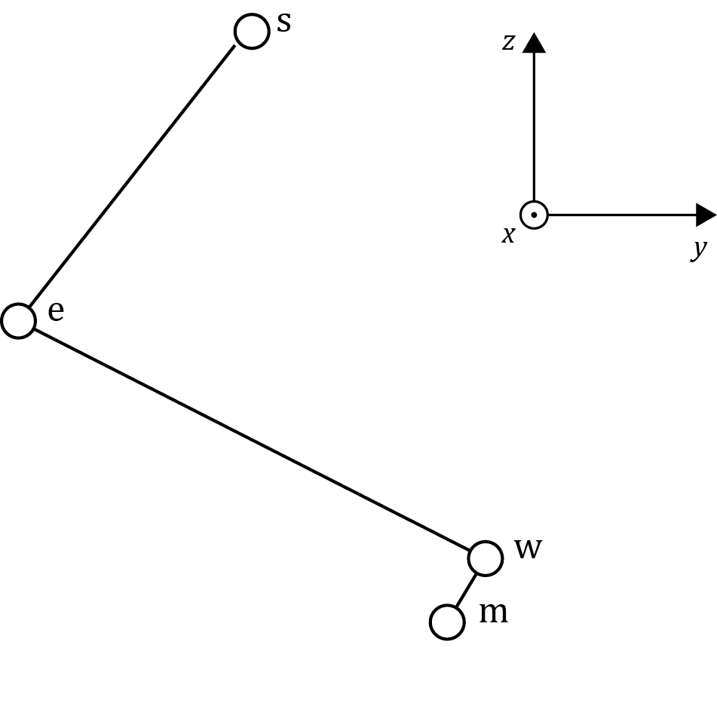
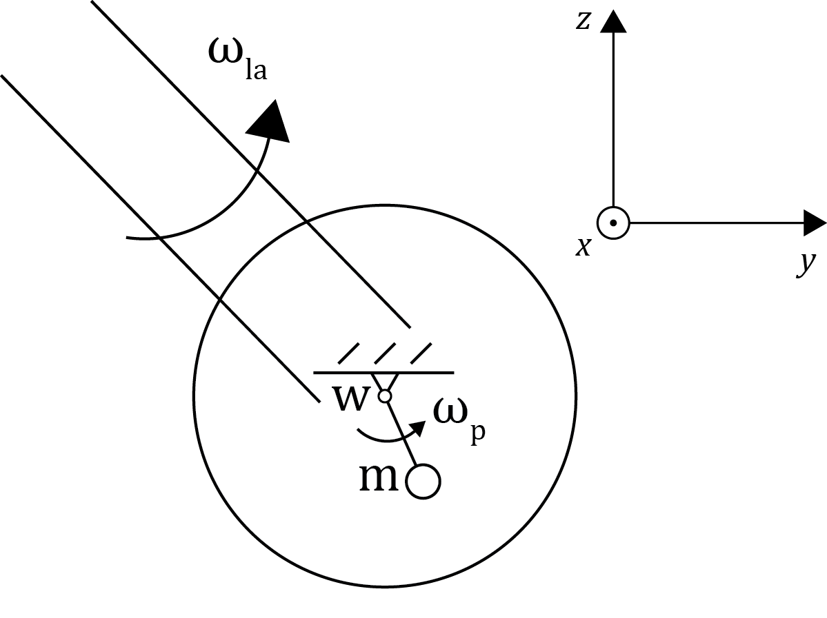
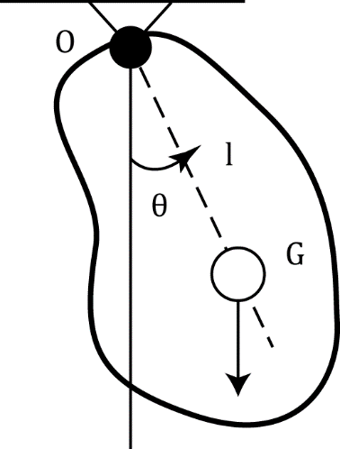



Modeling
New Moment of Inertia Model
$$J=\frac{T^{2}mgl }{{4π}^{2}}$$
$${\text{T}}_{rel}=\frac{1}{2}J{ω_{rel}}^{2}$$
$$ω_{rel}=ω_{p}{−ω}_{la}$$

Slide 34
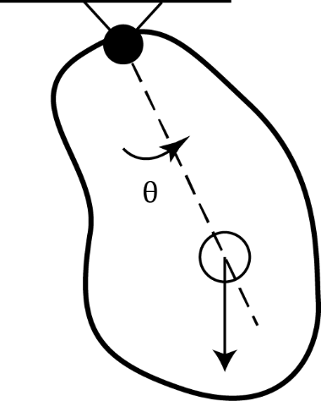
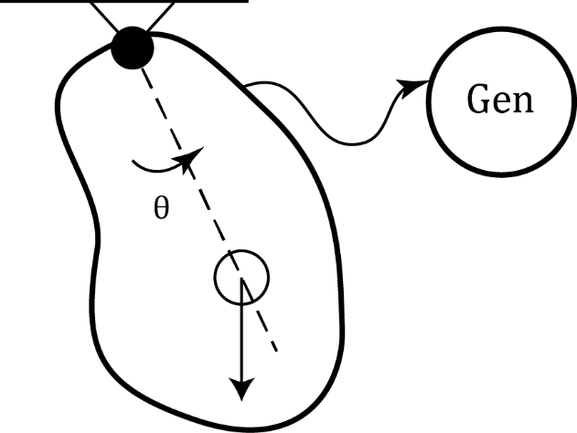
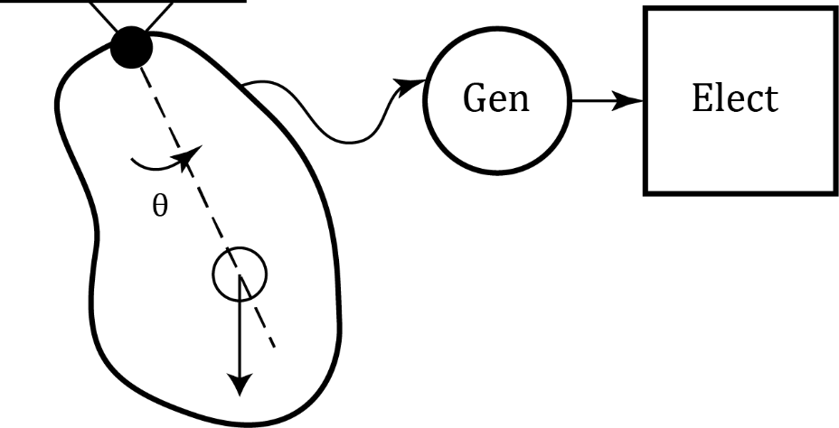
Experiments
Experiment 1
Experiment 2
Experiment 3

Slide 35
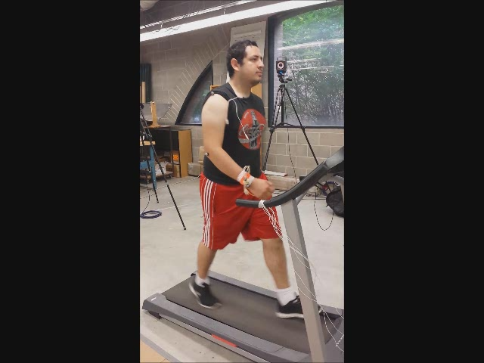
Testing Protocol - Walking
Walking Speed:
  2.5 mph
Test Duration:
  120 s
3 different tests:
  Power Generation
  NO Power Generation w/gears
  NO gear contact
3x 10s periods for data collecting

Slide 36
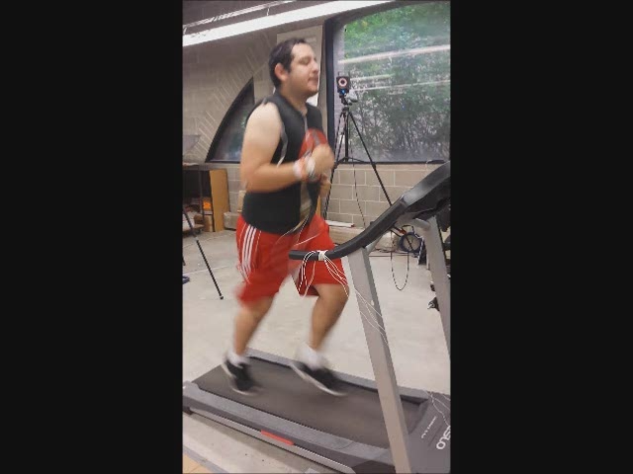
Testing Protocol - Running
Running Speed:
  5 mph
Test Duration:
  120 s
3 different tests:
  Power Generation
  NO Power Generation w/gears
  NO gear contact
3x 10s periods for data collecting

Slide 37
Results & Data Analysis

Slide 38
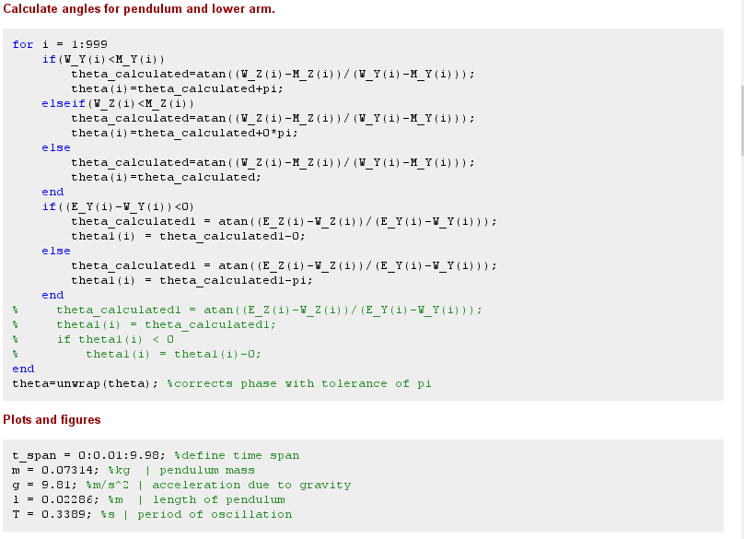
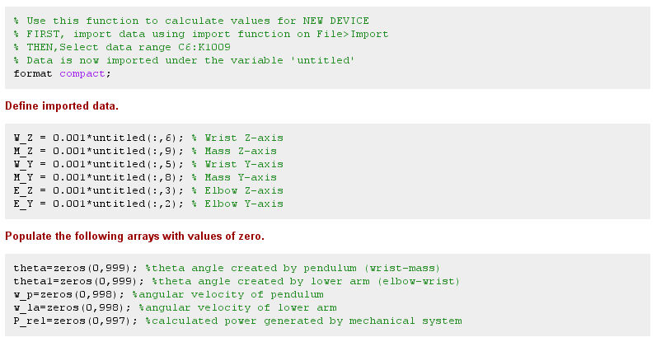
MATLAB Code Sample

Slide 39
Experimental Data (Running 5mph)

Slide 40
Kinetic Energy for Running 5mph

Slide 41

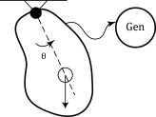
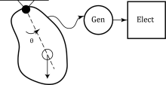
Kinetic and Electrical Energy
Average Energy (J)
 | E_{avg1} | E_{avg2} | E_{avg3} | E_{avg(elec)}
Old J=2.2e-4 kg m² | 0.02526 | 0.02396 | 0.0205 | 0.000579
New J=3.4e-5 kg m² | 0.0065 | 0.001433 | 0.000854 | 0.00006978
New₂ J=4.8e-5 kg m² | 0.003267 | 0.003266 | 0.002067 | 0.0002
E_{avg1}- No Gear Contact E_{avg2}- Gear contact no gen. E_{avg3}- Power gen.

Slide 42



Efficiency
Efficiency (%)
 | Ƞ₁ | Ƞ₂ | Ƞ_{total}
Old | 94.85 | 13.72 | 2.29
New | 22.05 | 8.92 | 1.07
New₂ | ~100 | 36.73 | 6.12

Slide 43
Summary
Available market for human generated power input for health monitoring
Compared to last year’s design:
  Doubled efficiency
  Smaller total dimensions and weight
  Ergonomic improvements
Further changes needed for improved electrical efficiency

Slide 44
Future Recommendation
Research available generators
Mitigate electrical energy losses due to rectification
Can be achieved by using higher quality diodes
Improve energy generation while maintaining acceptable efficiency
Adjust pendulum design for mounting of weights

Slide 45
Best Practices
Scheduling between group mates
Consulting alternative opinions
Accounting for lead times
Have a backup plan

Slide 46
Lessons Learned
Project requires more electrical knowledge than expected
Previous circuit experience was limiting
Extended research on generators
Proactive approach i.e. professional mode vs. student mode

Slide 47
References
http://www.cdc.gov/diabetes/statistics
http://www.nike.com/us/en_us/c/nikeplus-fuelband
http://www.fitbit.com/flex
https://jawbone.com/up
http://lark.com/products/lark-pro/features
http://fitness-trackers.findthebest.com/
http://endeavourpartners.net/assets/Wearables-and-the-Science-of-Human-Behavior-Change-EP4.pdf
http://www.roymech.co.uk/Useful_Tables/Drive/Gear_Efficiency.html
http://www.faculty.fairfield.edu/wdornfeld/ME312/ToothLoads04.pdf

Slide 48
Questions

Slide 49
Appendix

Slide 51
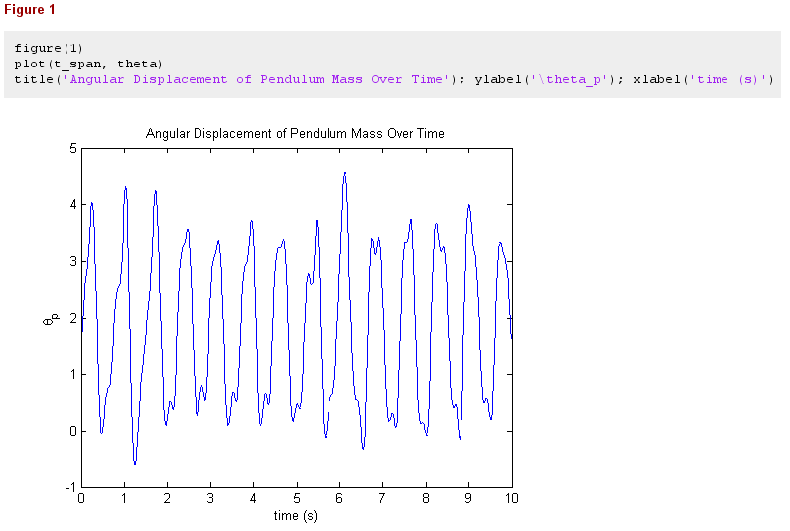

Slide 52


Slide 53


Slide 54


Slide 55


Slide 56


Slide 57


